Slide 1
VocabularY!

Slide 2
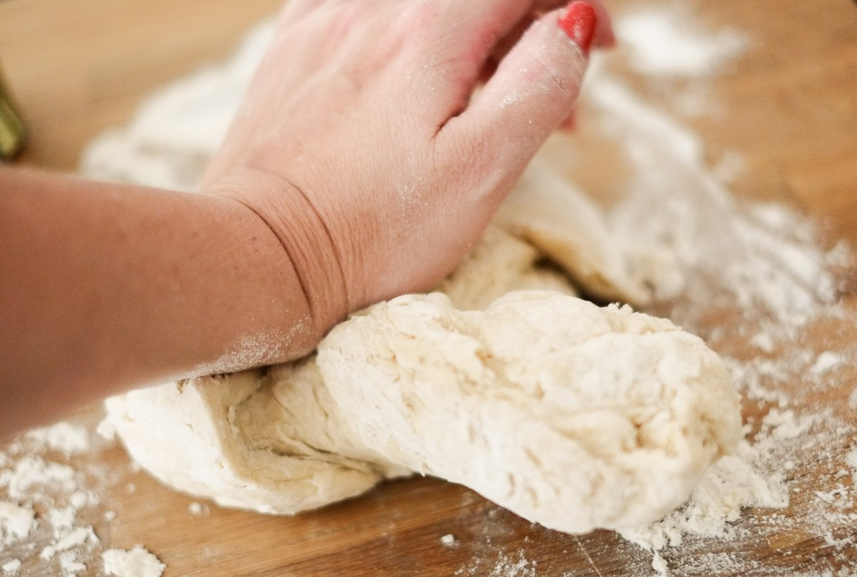
dough

Slide 3
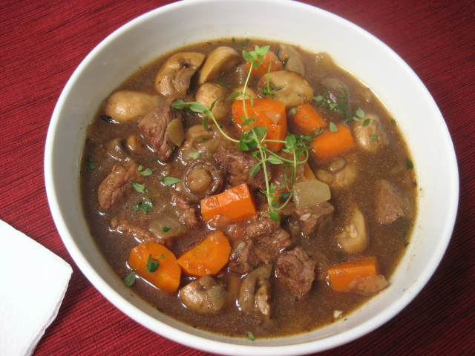
stew

Slide 4
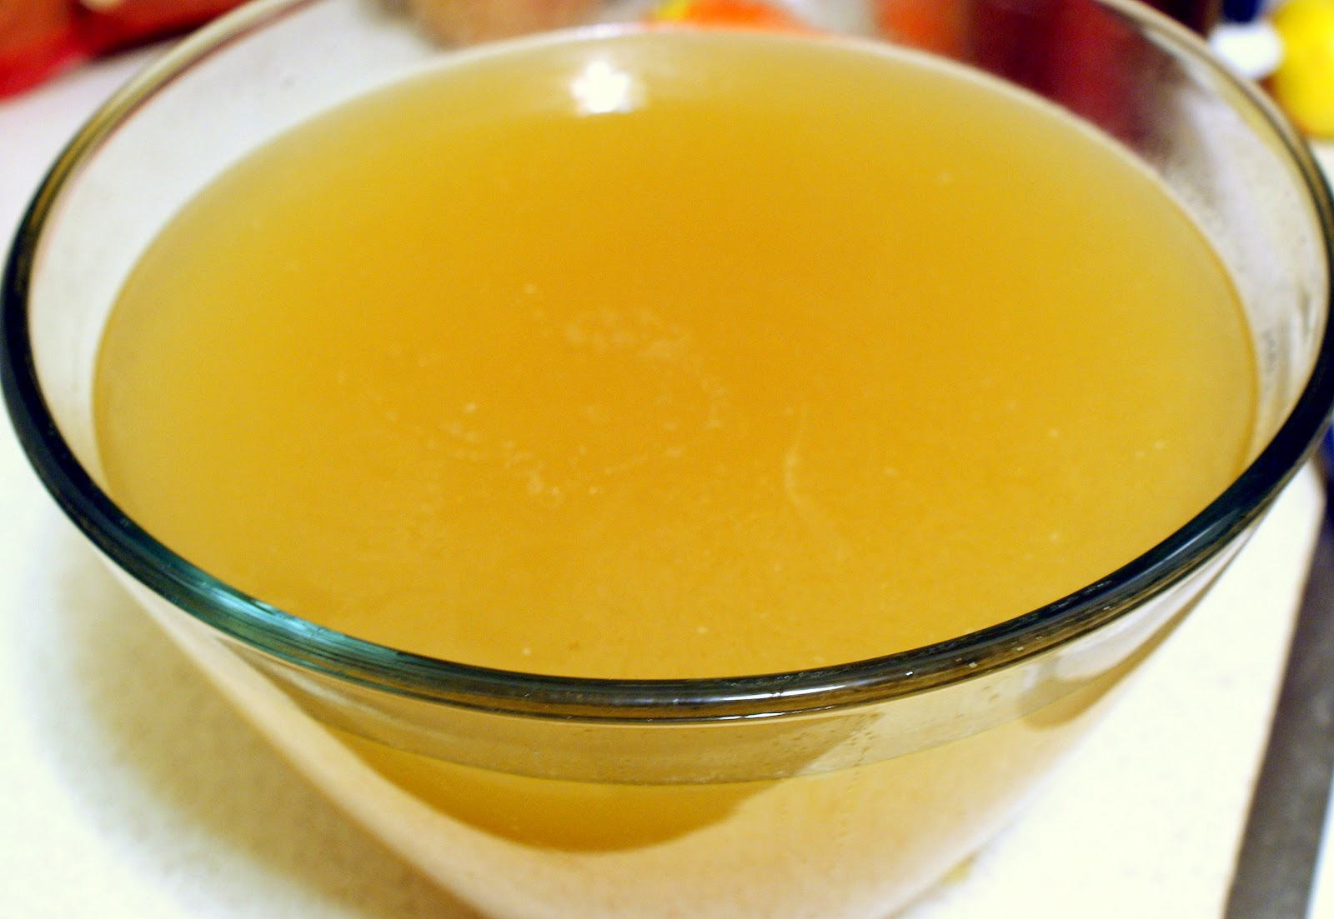
broth

Slide 5
dove

Slide 6
wand

Slide 7
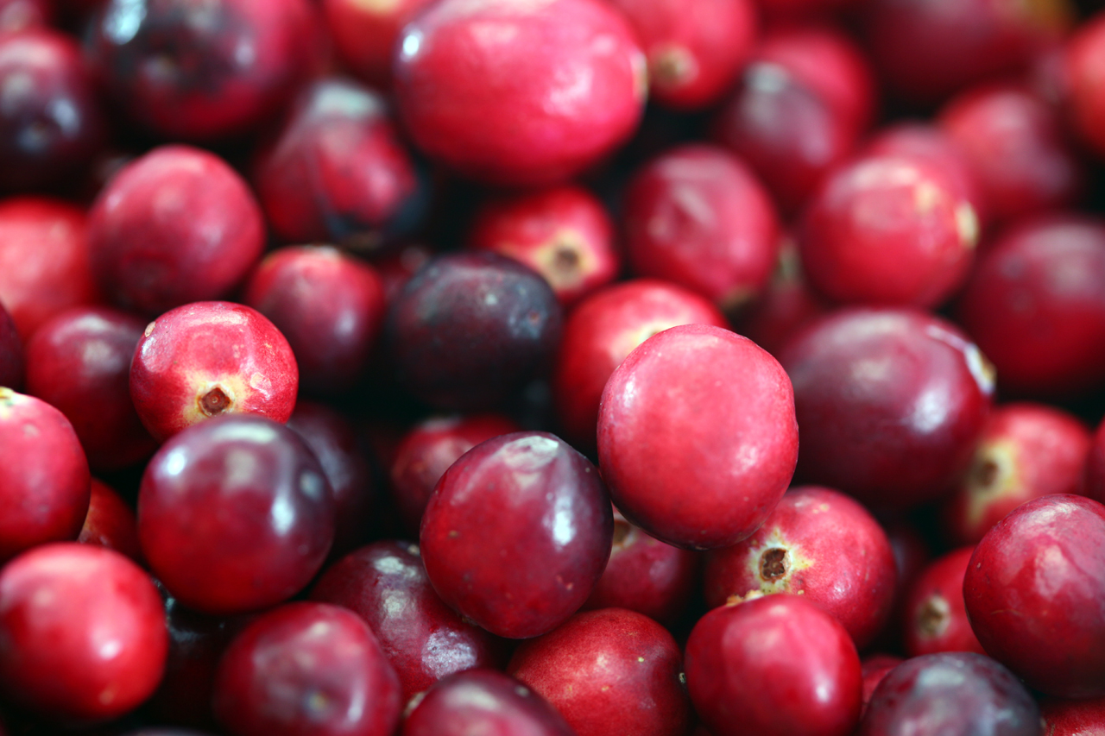
cranberry

Slide 8
mean

Slide 9
wise

Slide 10
wink

Slide 11
left?
right?
or

Slide 12
stew

Slide 13
dough

Slide 14
wand

Slide 15
wise

Slide 16
broth

Slide 17
wink

Slide 18
cranberry

Slide 19
mean

Slide 20
dove

