Slide 1
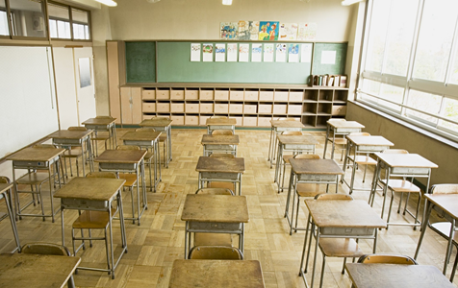
Use the pictures to complete the crossword and discover the topic of the lesson:
A
B

Slide 2
A
C | L | A | S | S | R | O | O | M
B

Slide 3
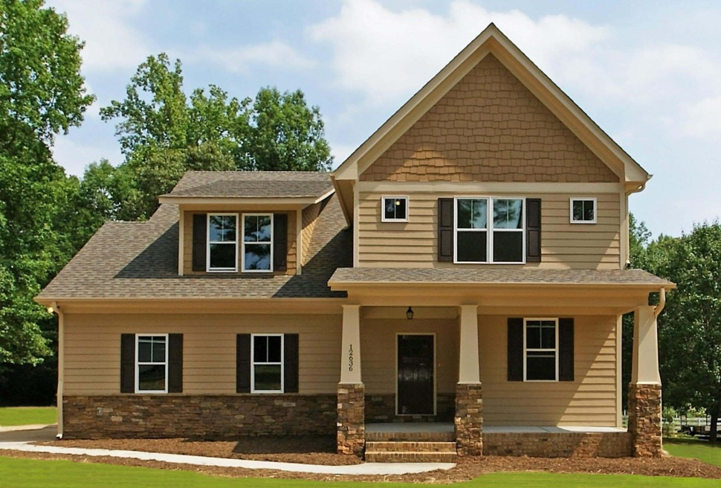
A
C | L | A | S | S | R | O | O | M
 | T | E | A | C | H | E | R
B

Slide 4
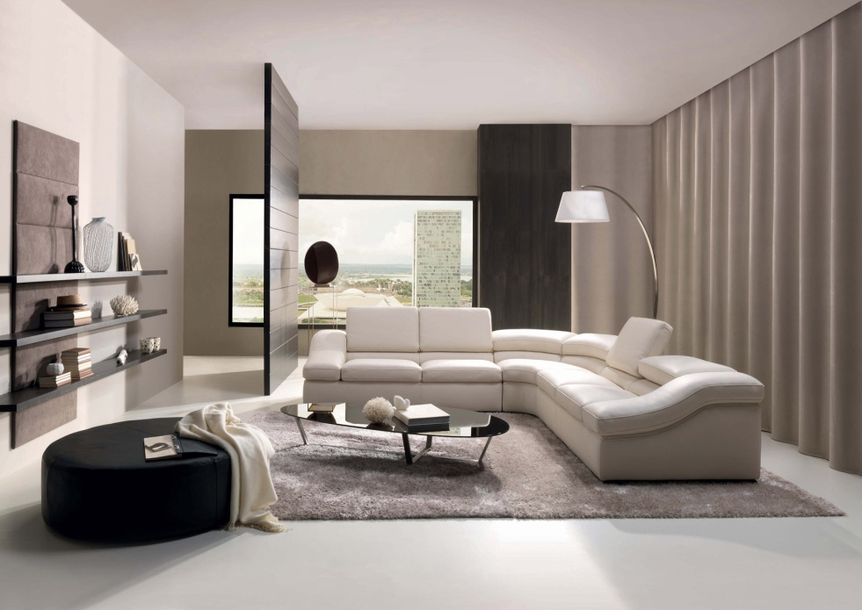
A
C | L | A | S | S | R | O | O | M
 | T | E | A | C | H | E | R
 |  |  |  | H | O | U | S | E
B

Slide 5
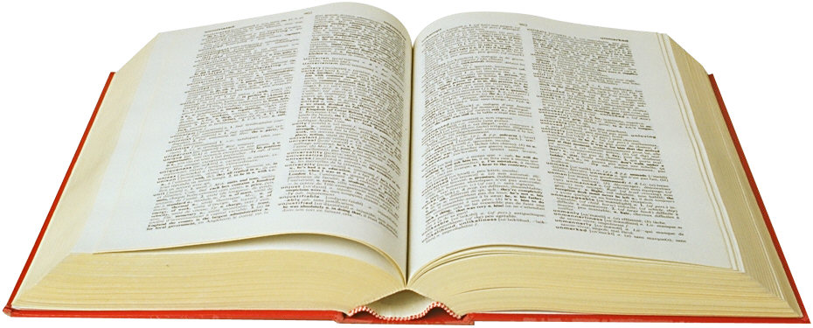
A
C | L | A | S | S | R | O | O | M
 | T | E | A | C | H | E | R
 |  |  |  | H | O | U | S | E
 |  |  | R | O | O | M
B

Slide 6
A
C | L | A | S | S | R | O | O | M
 | T | E | A | C | H | E | R
 |  |  |  | H | O | U | S | E
 |  |  | R | O | O | M
 |  |  | B | O | O | K
B

Slide 7
A
C | L | A | S | S | R | O | O | M
 | T | E | A | C | H | E | R
 |  |  |  | H | O | U | S | E
 |  |  | R | O | O | M
 |  |  | B | O | O | K
P | U | P | I | L
What is the topic
of our lesson?
B

Slide 8
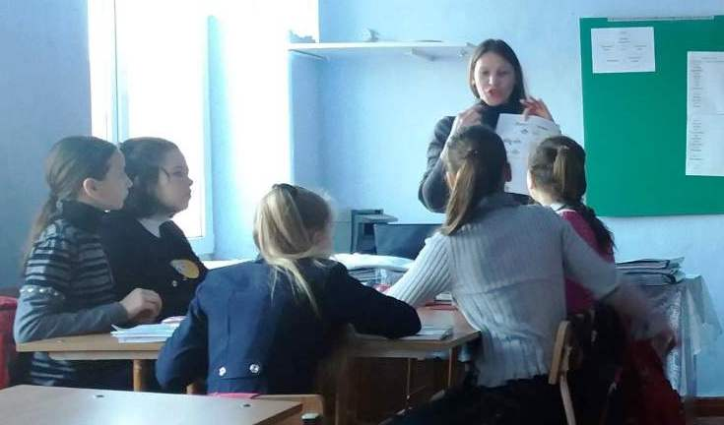
Lesson topic: SCHOOL
The 5th form
Teacher:
Mariana Ursu

Slide 9
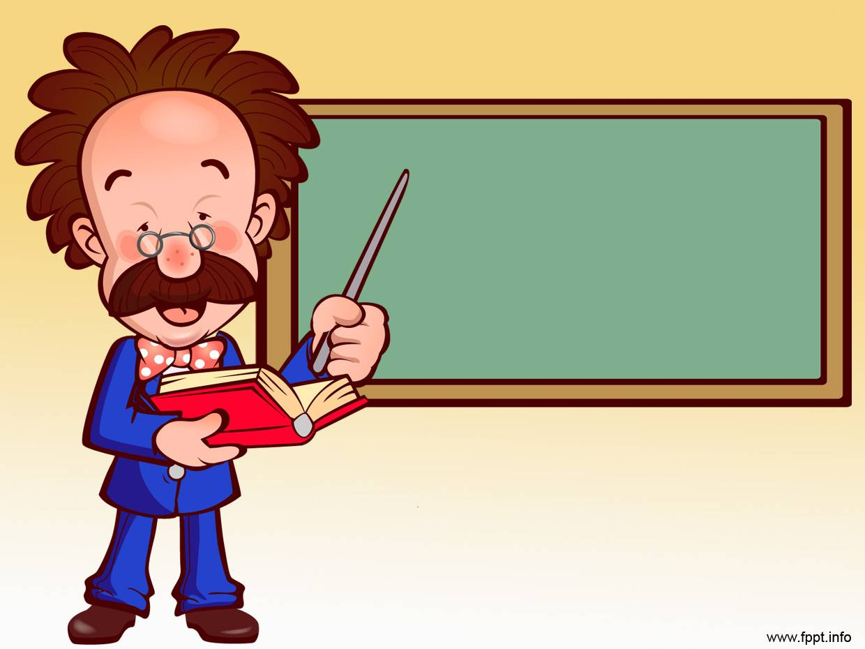
At the end of the lesson you should be able to:
- name some new words connected with the topic;
- describe your school;
- talk about your school activities;
- compare the things, using the correct form of the adjectives.

Slide 10
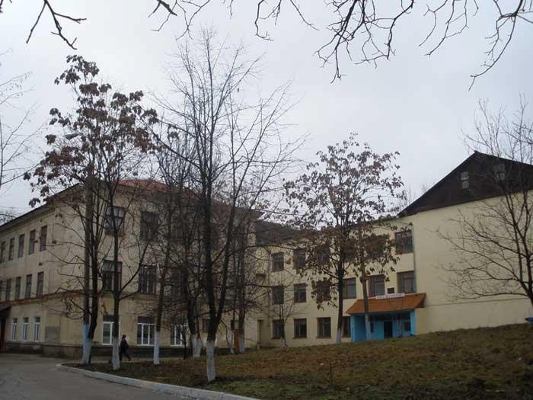
SCHOOL
Vocabulary revision

Slide 11
Discussion focus

Slide 13
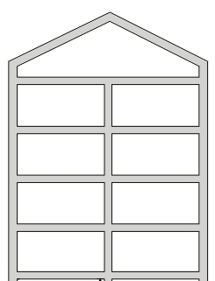
School
The third
floor
The second
floor
The first
floor
The ground
floor

Slide 14
New vocabulary
Word Bank

Slide 15
Complete the sentences with the words from Word Bank:
The boys played a football _______ on Sunday.
The musicians play in an _________.
We work __________ at school.
After school we have _______ things: play basketball, dance and sing songs.
Our classmates ________ during the breaks.
During the lessons we _________ _________ on different topics.
Our English classes ___________ _________ in the English classroom.

Slide 16
Grammar focus

Slide 17
Compare the things:
long
longer
Ex: The ruler is longer than the pen.

Slide 18
short
shorter
the shortest
Ex: The grey pencil is short.
The blue pencil is shorter.
The black pencil is the shortest.

Slide 19
Form the comparison of the adjectives:
Clean-
Light –
Small –
Large-

Slide 20
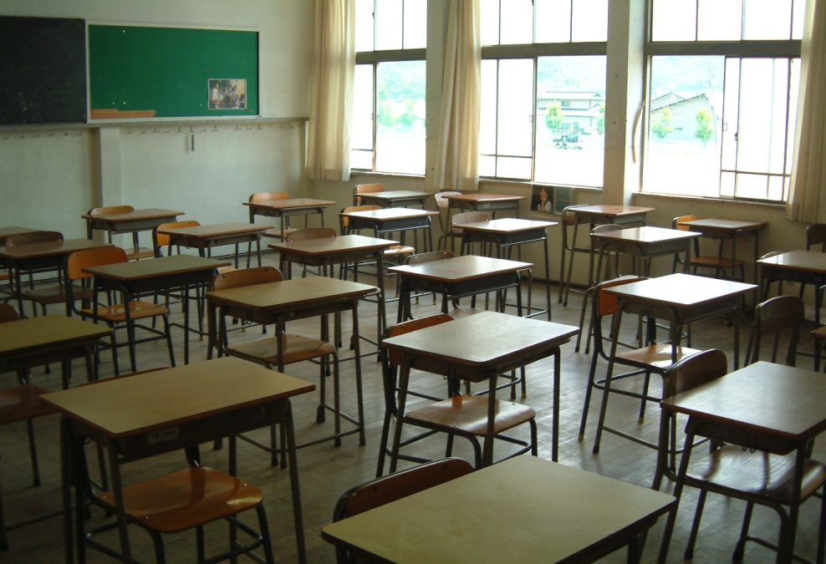
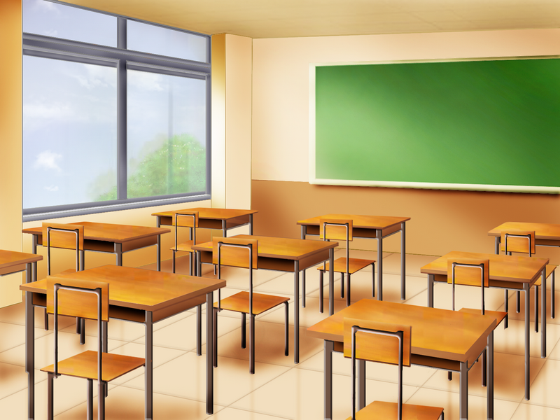
The English room
large, light
The Romanian room

Slide 21
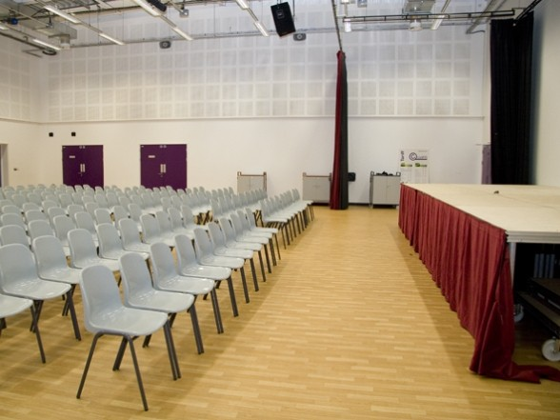
The assembly hall
large

