Slide 1
Verb forms!

Slide 2
Susan

Slide 3
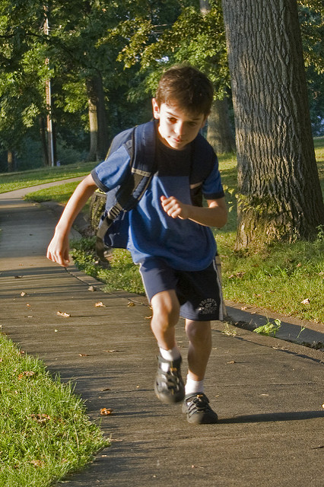
John

Slide 4
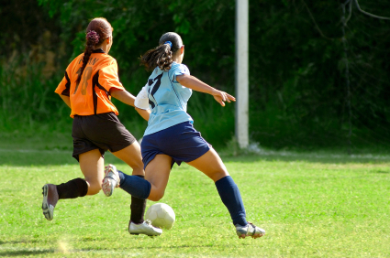
Mary and Sarah

Slide 5
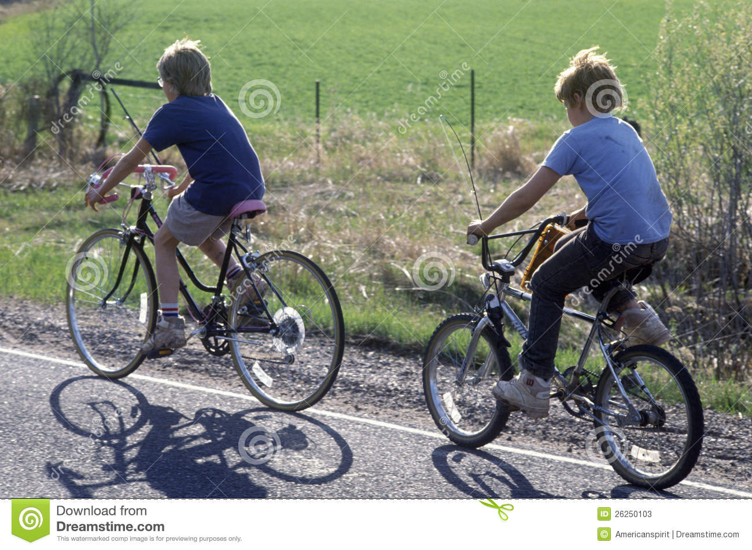
David and Steve

Slide 6
The girl

Slide 7
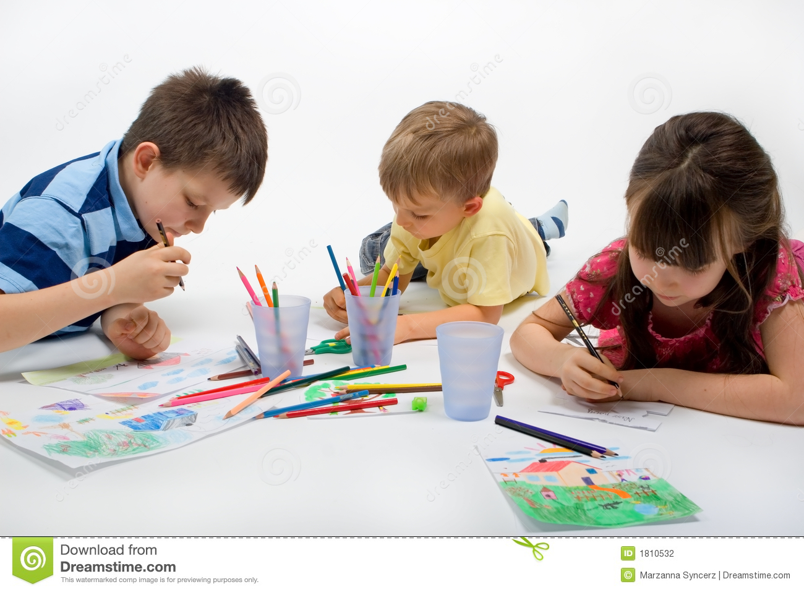
The children

Slide 8
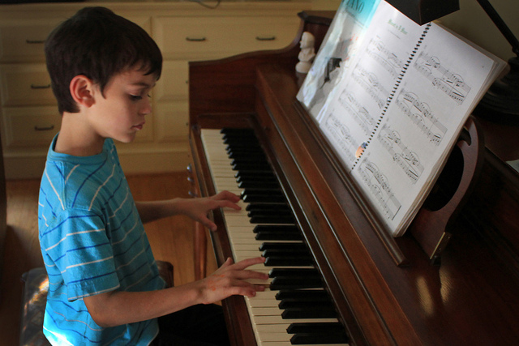
The boy

Slide 9
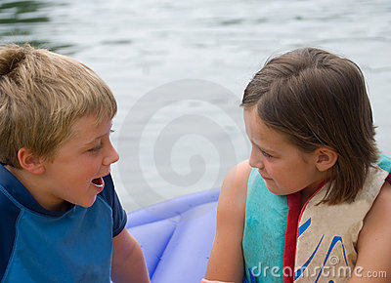
Alex and Angela

