Slide 1
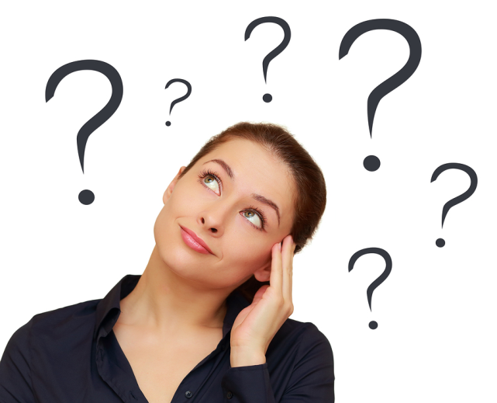
Do you recognize the persons in the pictures?

Slide 2
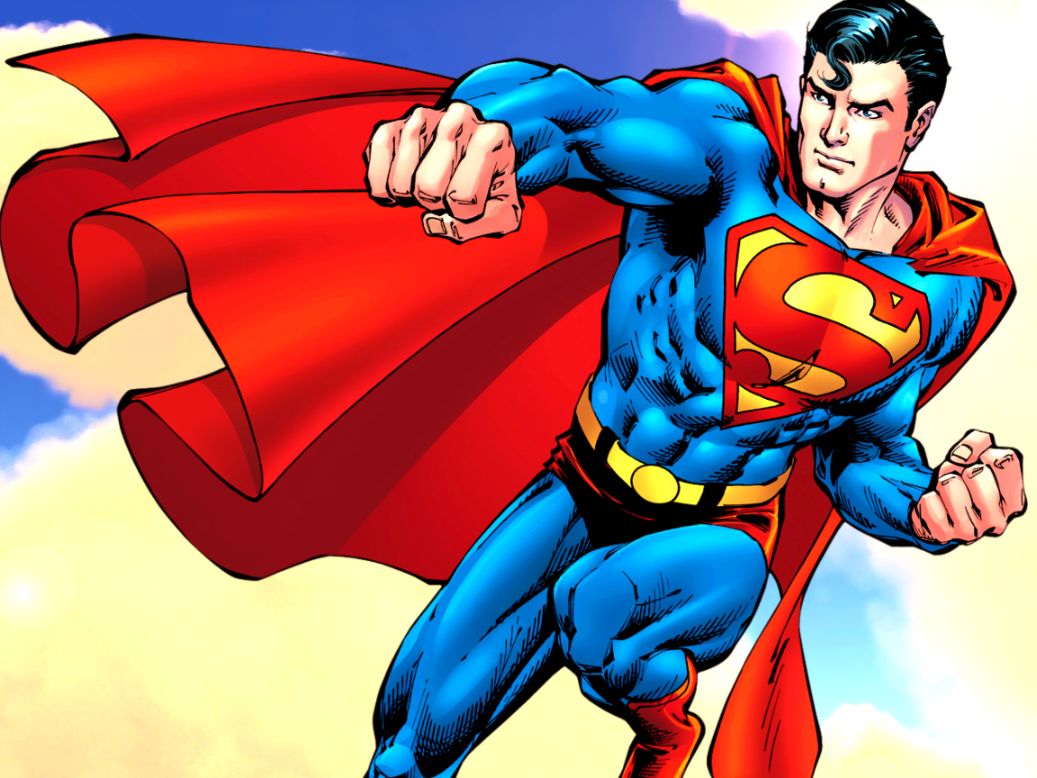
Superman

Slide 3
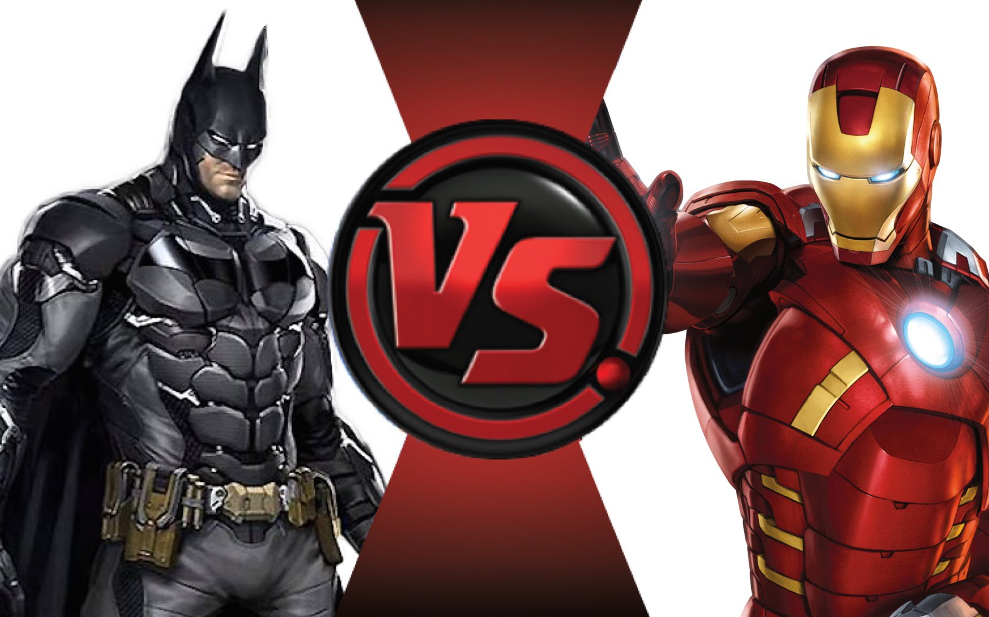
and Ironman
Batman

Slide 4
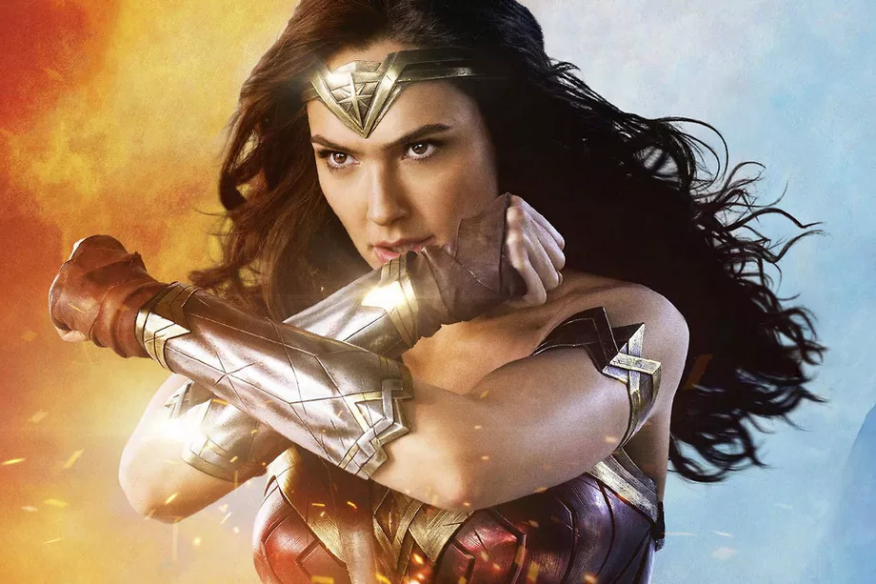
Wonder Woman

Slide 5
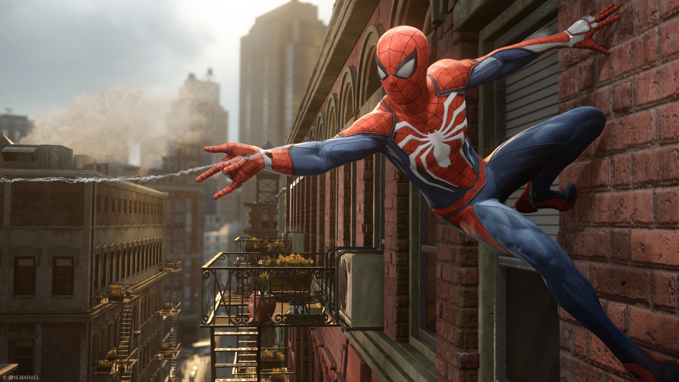
Spider-Man

