Slide 1
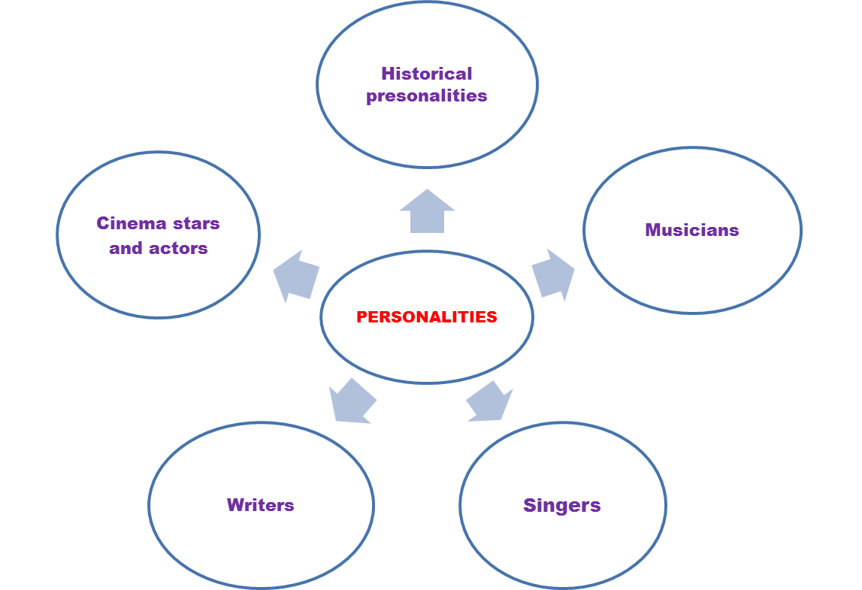
Work in groups and complete the clustering:

Slide 2
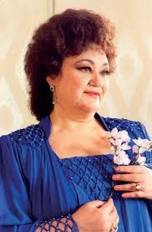
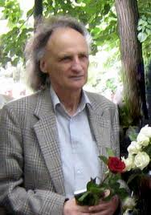
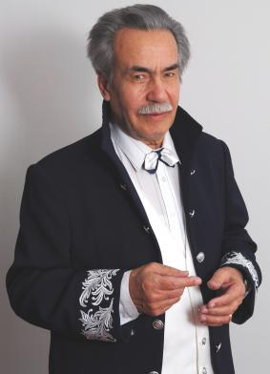
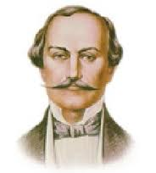
Do you recognize these personalities?
Alexei Mateevici
Maria Bieşu
Grigore Vieru
Alexandru Donici
Dumitru Matcovschi

Slide 3
What do you know about them?
Know | Want to know | Learned

Slide 4
ROUND UP
Quiz game

Slide 5
PERSONALITIES
The UK
SEAPORTS
HOUSING
GRAMMAR

Slide 6
PERSONALITIES
Who was Shephan the Great?
10 points

Slide 7
PERSONALITIES
Who was Oliver Cromwell?
20 points

Slide 8
PERSONALITIES
What is Oliver Cromwell famous for?
30 points

Slide 9
PERSONALITIES
Who and what kind of personality was Horatio Nelson? (name 3 of his main characteristics)
40 points

Slide 10
PERSONALITIES
Enlist at least 3 three interesting facts about the reign of Shtephan the great.
50 points

Slide 11
PERSONALITIES
Name the monument that was built in Nelson’s honor, speak about its appearance and location.
60 points

Slide 12
PERSONALITIES
What Nelson’s well known words were written on the flagship?
“England expects that every man ought to do his duty.“
70 points

Slide 13
The UK
What is the official name of the UK?
10 points

Slide 14
The UK
What are the parts of the UK?
20 points

Slide 15
The UK
Name the capital of the UK, enlist 3 interesting facts about the city?
30 points

Slide 16
The UK
Name the symbol of each part, say what is it famous for.
40 points

Slide 17
The UK
Name 3 cities from the UK (except the capital), say what are they known for.
50 points

Slide 18
The UK
Name at least 6 sights of London.
60 points

Slide 19
The UK
What waters is the UK surrounded by?
70 points

Slide 20
SEAPORTS
How many ports does Moldova have? Which are they?
10 points

Slide 21
SEAPORTS
What is the largest and the most populated seaport in the USA?
20 points

Slide 22
SEAPORTS
What is the second largest seaport in the USA and what is it known for?
30 points

Slide 23
SEAPORTS
Where is the port of Los Angeles located and what is its surface?
40 points

Slide 24
SEAPORTS
What is New York famous for?
50 points

Slide 25
SEAPORTS
Where is the port of Singapore situated and what is famous for?
60 points

Slide 26
SEAPORTS
Describe the climate in Singapore.
70 points

Slide 27
HOUSING
Name at least 6 types of houses people live in.
10 points

Slide 28
HOUSING
What types of houses do British and American people prefer? What are they built of?
20 points

Slide 29
HOUSING
What can you say about the size of the British and American houses?
30 points

Slide 30
HOUSING
What are 2 specific things for a British houses?
40 points

Slide 31
HOUSING
What additional rooms does an American house have? Where are they located?
50 points

Slide 32
HOUSING
Name 3 things that British and American houses have in common.
60 points

Slide 33
HOUSING
Name 3 specific things for a traditional Moldovan house.
70 points

Slide 34
GRAMMAR
Report the following statement:
The student said, “Singapore became
a British colony on August 2, 1824.”
10 points

Slide 35
GRAMMAR
Fill in the article the where necessary, explain the rules:
“... Constanţa is the most important seaport
on the coast of ... Black Sea.”
20 points

Slide 36
GRAMMAR
Open the brackets using Present Perfect or
Present Perfect Progressive, explain your option:
My sister already (whitewash) the walls.
30 points

Slide 37
GRAMMAR
Open the brackets using Present Perfect Progressive or Past Perfect Progressive, explain your option:
The painters (paint) the doors and windows
for 5 hours.
40 points

Slide 38
GRAMMAR
Open the brackets using Present Perfect Progressive or Past Perfect Progressive, explain your option:
When mother entered the house,
Ann (to dust) the furniture for ten minutes.
50 points

Slide 39
GRAMMAR
Report the following statement:
Mother said, “My son, how long have
you been playing computer games?”
60 points

Slide 40
GRAMMAR
Introduce the verb “to fire” in 3 sentences to have different meanings, giving a synonym for each case.
70 points

